Slide 1
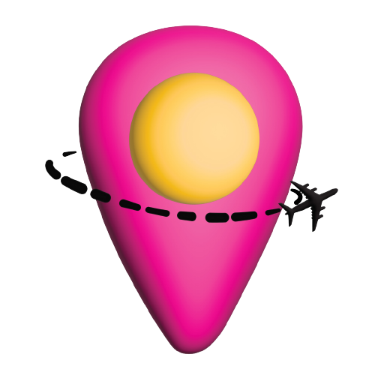
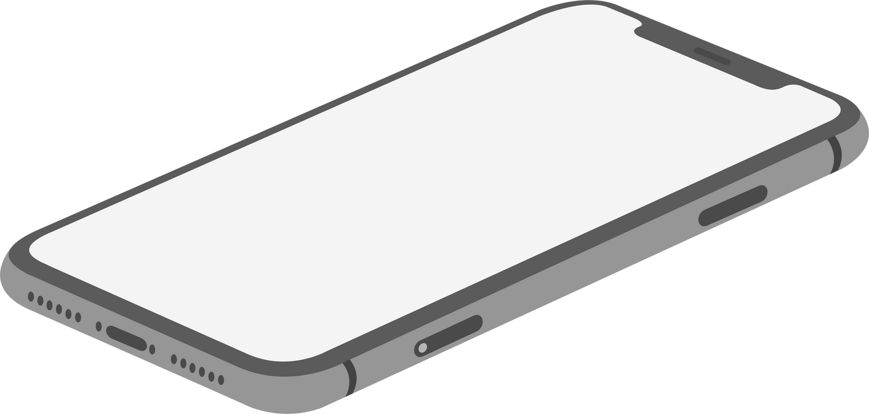

Let the travel planning begin...
Capstone
Project:
DropPoint
Presented by
Brenda Garcia & Glenda Garcia

Slide 2
Travel planning never looked so easy!
Have you ever found yourself feeling frustrated when planning to travel? Asking yourself questions like where to visit, and when?
Then it is time to plan! But don't worry because with DropPoint all of the headaches involved with planning to travel are gone.

Slide 3
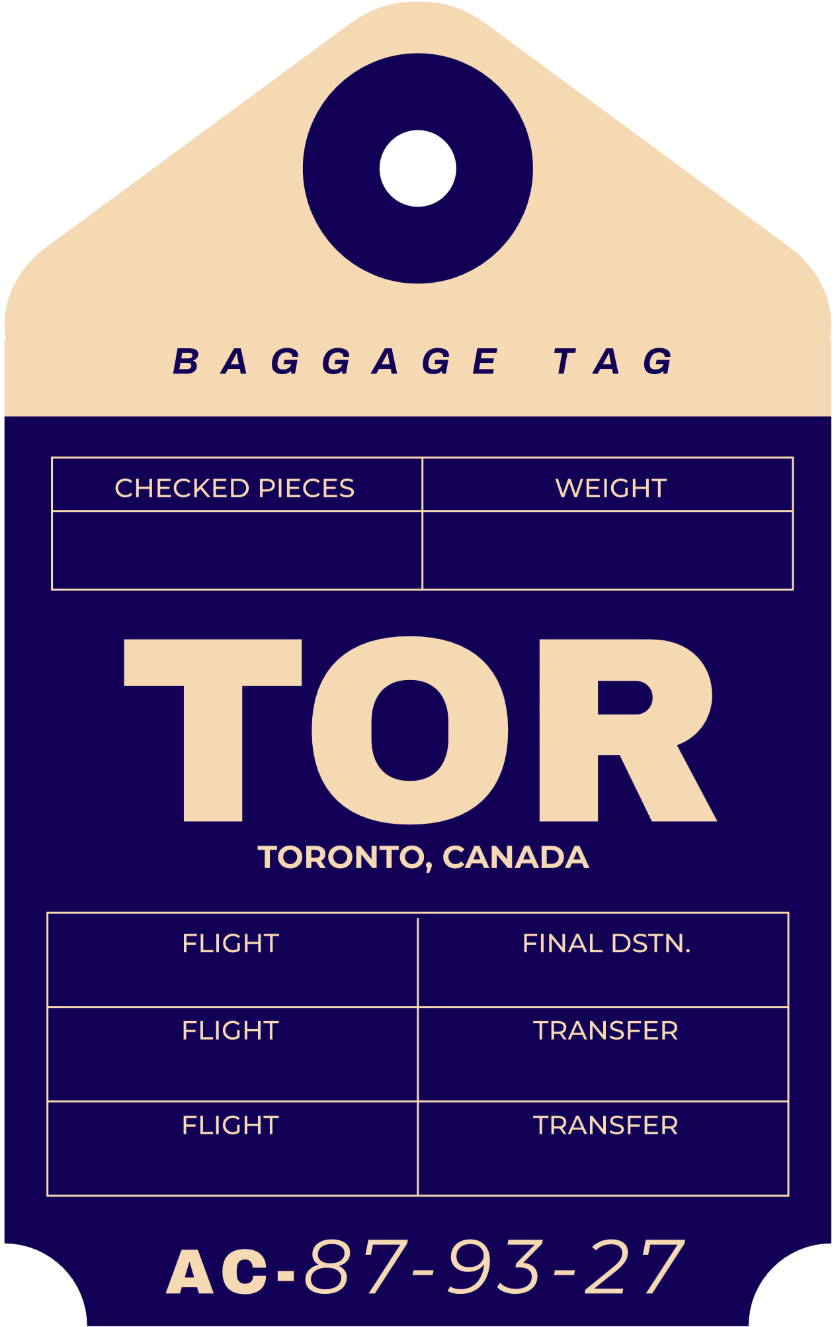
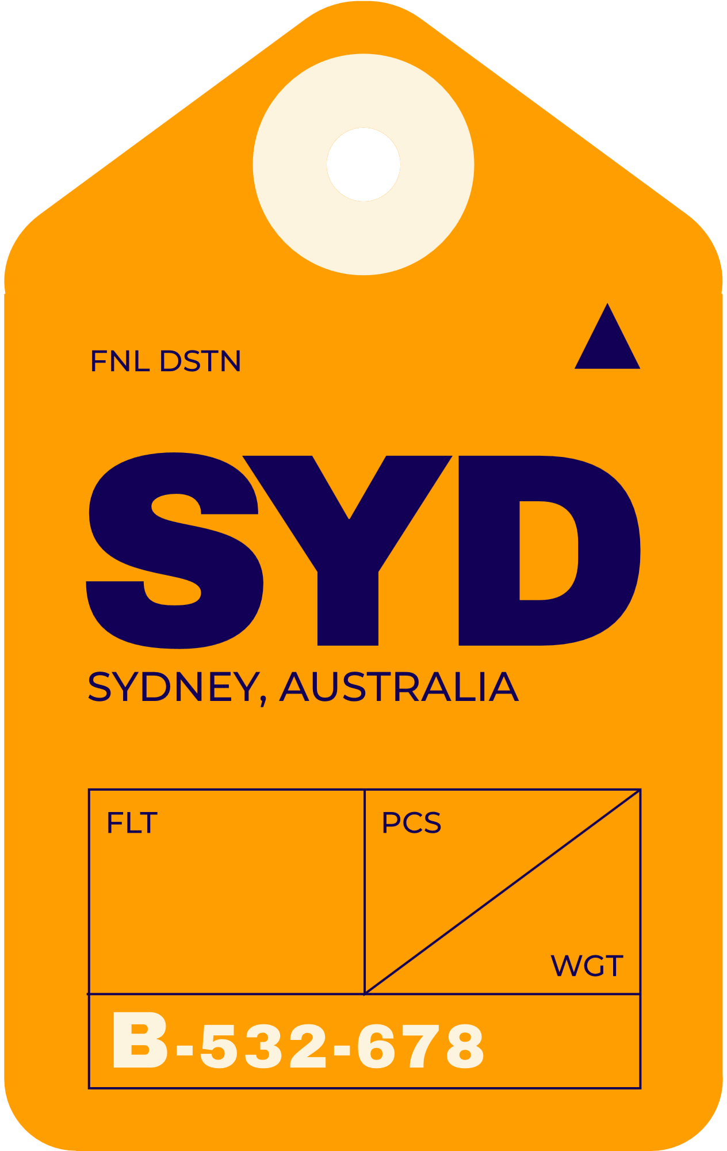

Overview
Plan for traveling
Discover new places
Join a travelers community
DropPoint has the tools to make your life easier when planning a new travel experience.The platform offers advice and photos of the place from other travelers who have been there.
The application behaves similar to social networks like Instagram: enabling users to view publications shared by others, read their advice, experience, and add these publications to their itinerary for a trip.
DropPoint is targeted at those adventurers who like to share their latest travels along with their experiences, and recommendations.

Slide 4







Technologies Used
Android Studio
Java
XML
Firebase
HTML
CSS
Google APIs

Slide 5



Create an account/Login
Provide a map view of publications shared
Functionalities
of the App
Search locations found near a desired place
Share your travels with others
Bookmark publications and store them in folders for each trip

Slide 6
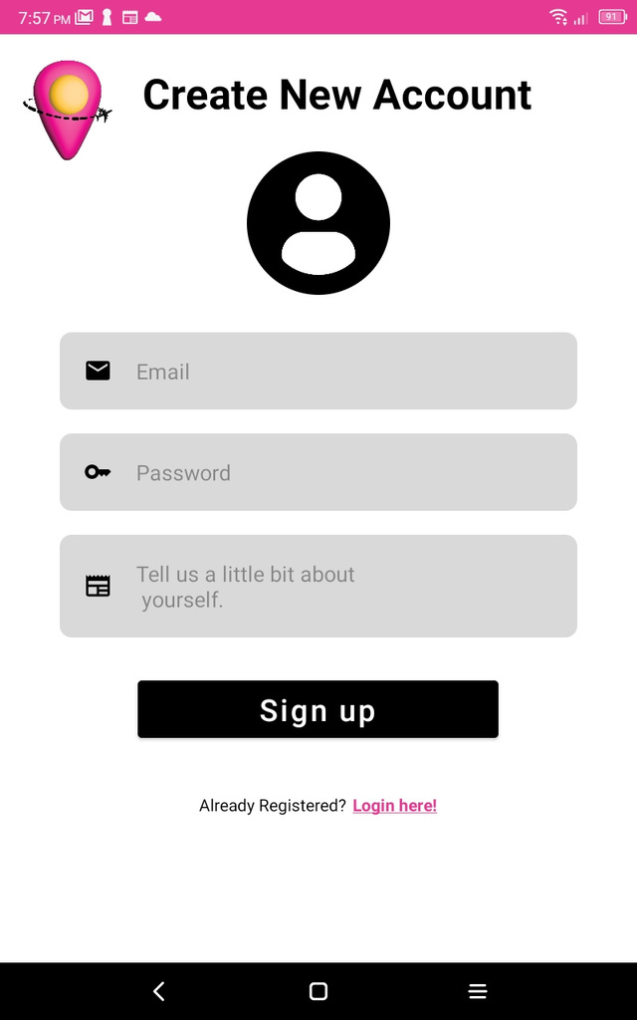
Create an account
From the Login screen click on "Sign up!"
Enter email:
Validation for a correct email format is implemented.
Enter password:
Password must meet the following criteria:
At least 1 upper case and 1 lower case.
At least 1 number.
No space.
Length: 6 to 20 characters.
Enter small biography.
Text size dynamically adjusts to allow full sentences to be seen.
Upload photo.
Tapping on the profile icon opens up the gallery.
Picture selected stays within the circle shape.
All above fields must not be empty, else, an error message will pop up next to the empty field.

Slide 7
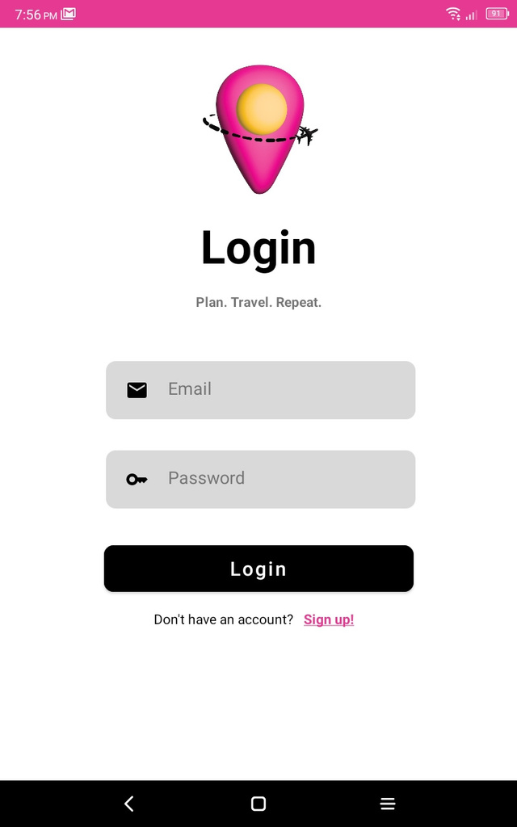
Login
Users who have an account can enter their email and password to login.
Validation is accordingly implemented throughout both fields.
Logic/Implementation:
Firebase provides simple authentication with just the user's email and password.
The extra work behind building a backend for user authentication, and securing this sensitive data is taken away with Firebase's Authentication services.
After a successful login, the Firebase's services are used to keep the user logged in or to enable logout when desired by the user.
The User UID that Firebase automatically generates for each account is then used to handle storing data for each user.

Slide 8
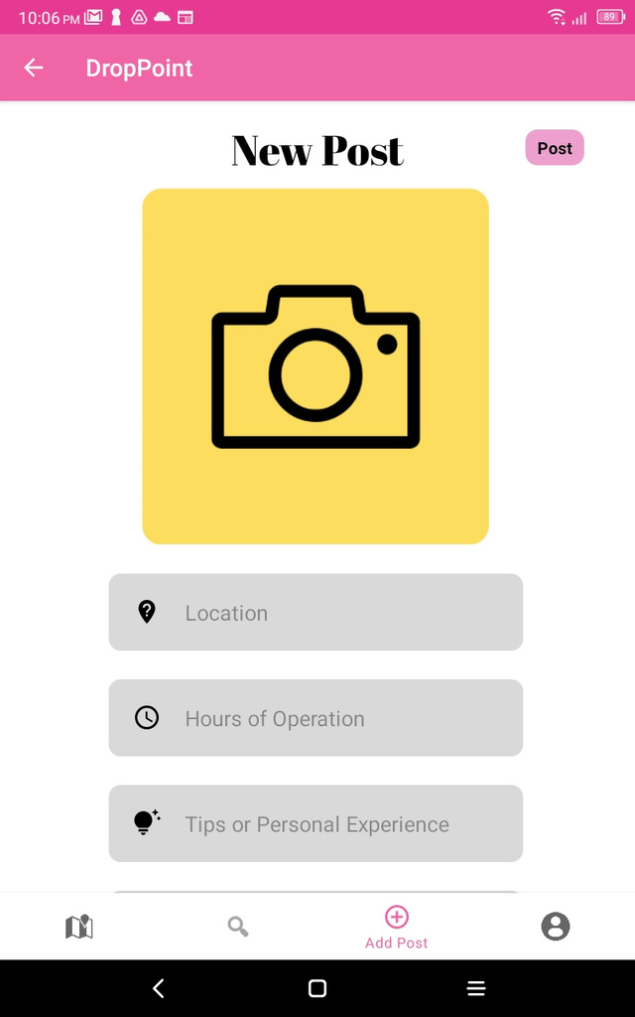
Share your travels with others:
The "Add Post" view requires users to:
Upload an image:
Tapping on the camera icon opens up the gallery.
Picture selected stays with rounded borders, yet the image's own size ratio is maintained.
Enter a location:
The Google Places API is used to power the entering of a location.
Its implementation is a way to validate locations entered by users to keep good data in database for the map view.
This API is a service that takes HTTP requests and returns data about locations on Earth.
Optionally share: hours of operation, personal experience, and tips.

Slide 9
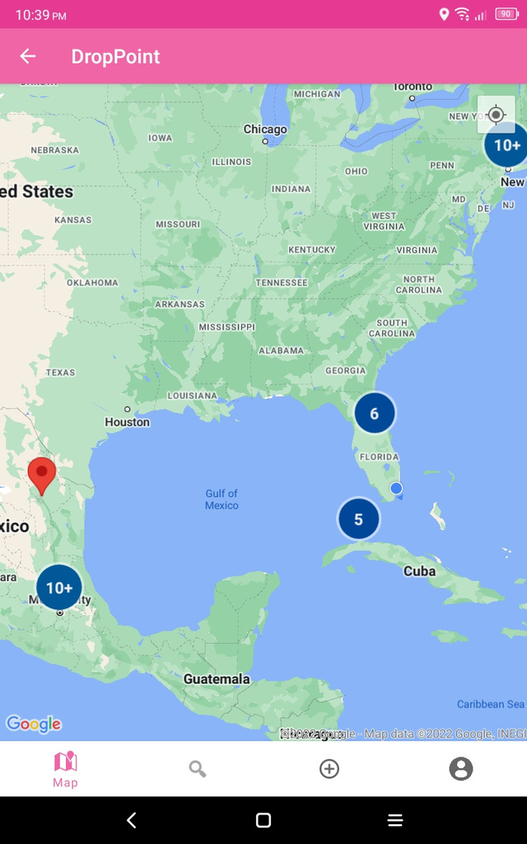
Provide a map view of publications shared:
DropPoint brings a customized map that enables user engagement and helps visualize different map pins that are scattered throughout the whole map pointing to the location where each photo has been taken.
The Maps SDK for Android was used in order to add a Google Map to the app.
For the clustering markers of the posts the Google Maps Android Marker Clustering Utility was used.
Users first time accessing this view, have the opportunity to choose whether to accept or deny for the app to access the user's current location.

Slide 10
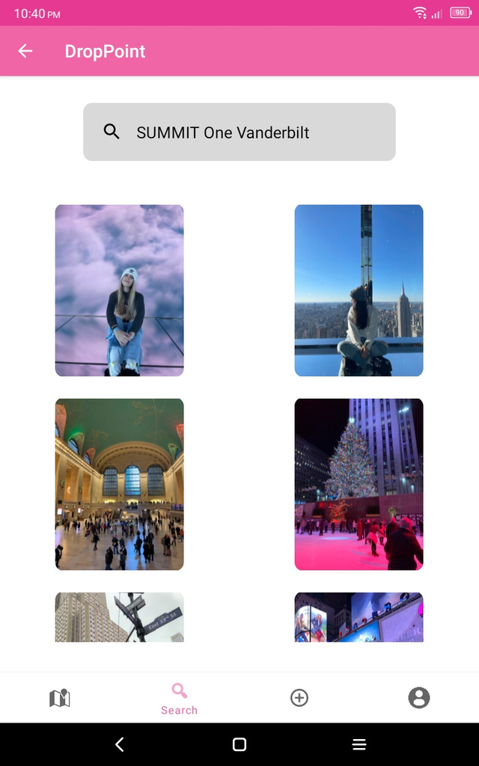
Search locations found near a desired place:
DropPoint provides an extra way for optimizing the search of publications in the form of a search view.
Users are free to enter their desired location in a search box powered by the Google Places API.
Firebase offers Geo Geohashes which were implemented in order to store and query posts by position.
Searching for locations in this view will bring up a grid view of the search results which can be accessed individually.

Slide 11
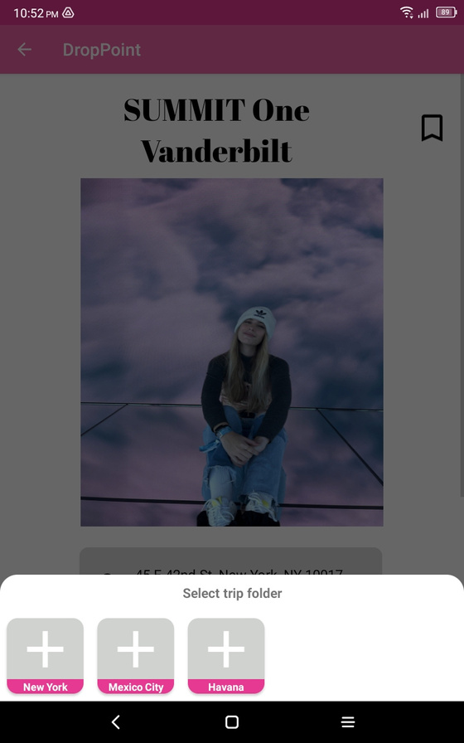
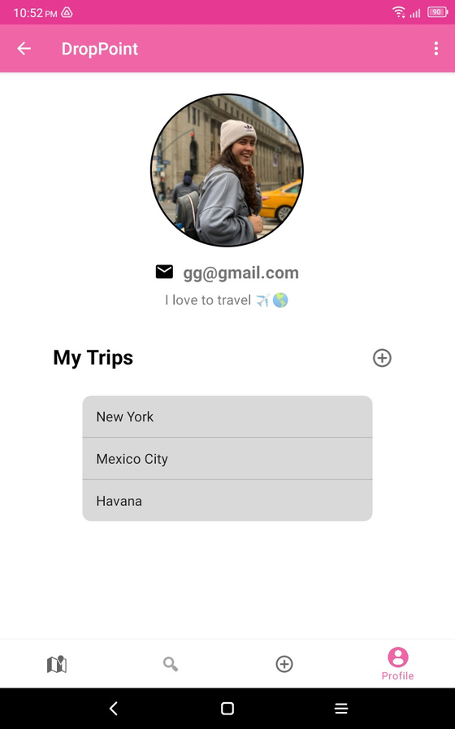
Bookmark publications and store them in folders for each trip:
Each post can be bookmarked.
Since a user may want to add the post to various folders, DropPoint enables users to have a single post in many folders
If a post has previously been placed to a folder, the app makes sure that no duplicates of that post are added.
The user can see their bookmarked posts in their profiles, which will be displayed inside of the folders for each trip added by the user.

Slide 12



Roles of Team members
Brenda Garcia
Glenda Garcia
Android developer
UI/UX Designer
QA Engineer
Android developer
Backend developer
QA Engineer

Slide 13










Future additions
Change profile information
Forgot password
Upload multiple photos to a post
Optimize searching of locations
Strengthen implementation for the back arrow
Trip Itinerary & Budget Planning
Display the user profile where a post originated from
Like, comment, provide feedback, allow conversation among users
App to be iPhone compatible and make up available on the Play/App Store
Delete trips folders, posts, bookmarks, user account

Slide 14
Lessons Learned
Cloud hosted and document-based databases like Firebase
1
Full stack development of an Android Mobile Application
2
3
The power of APIs and SDKs
A successful endeavor requires dedication, Google's assistance from time to time, hard work and a lot of patience.
4

Slide 15
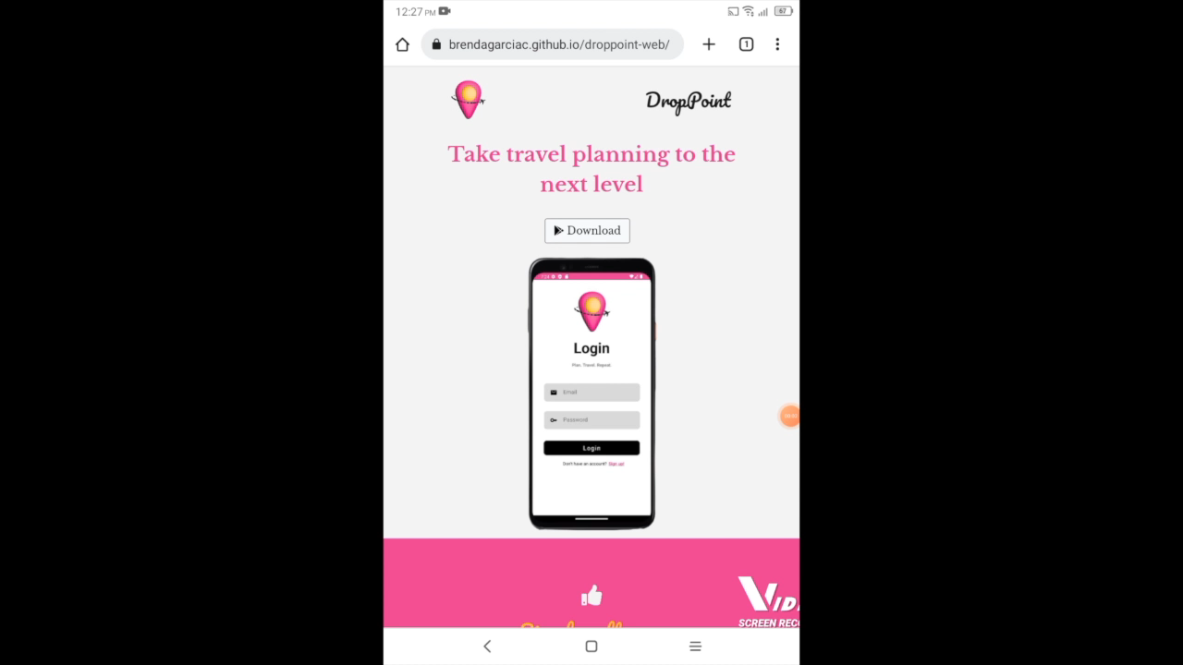
DropPoint Installation
https://brendagarciac.github.io/droppoint-web/

Slide 16

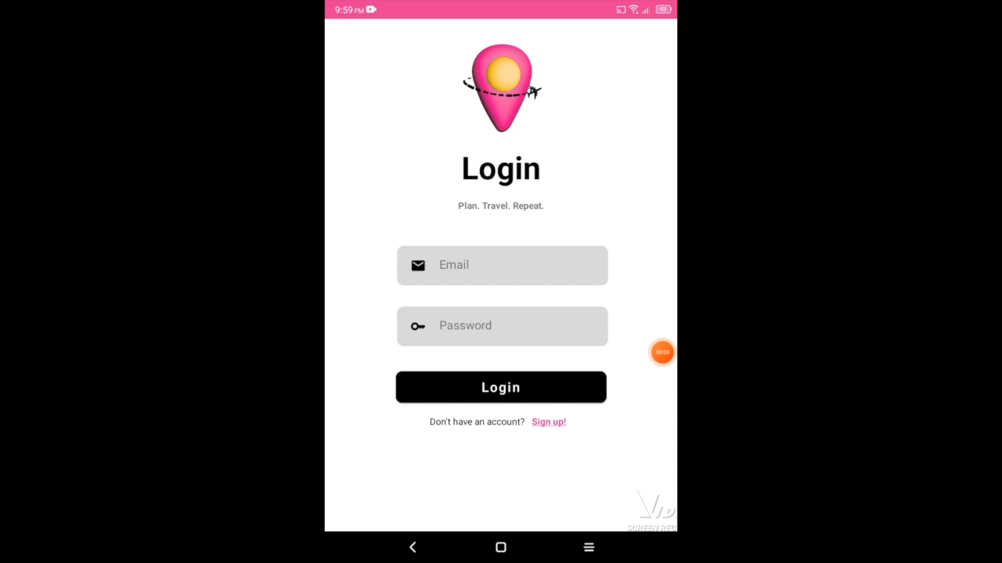
Let's see DropPoint
in action!

Slide 17
Resources Page
These are some of the pages that helped us during the development of the DropPoint application.
Google Maps Platform:
https://mapsplatform.google.com
Firebase Geohashes:
https://firebase.google.com/docs/firestore/solutions/geoqueries#solution_geohashes
Google Maps Android Marker Clustering Utility:
https://developers.google.com/maps/documentation/android-sdk/utility/marker-clustering
Glide Library (for displaying images):
https://github.com/bumptech/glide
Google Fonts:
https://fonts.google.com/specimen/Abril+Fatface?preview.text=New%20Post&preview.size=75&preview.text_type=custom#styles
Picasso Library (Circle Image View):
https://github.com/hdodenhof/CircleImageView#circleimageview

Slide 18
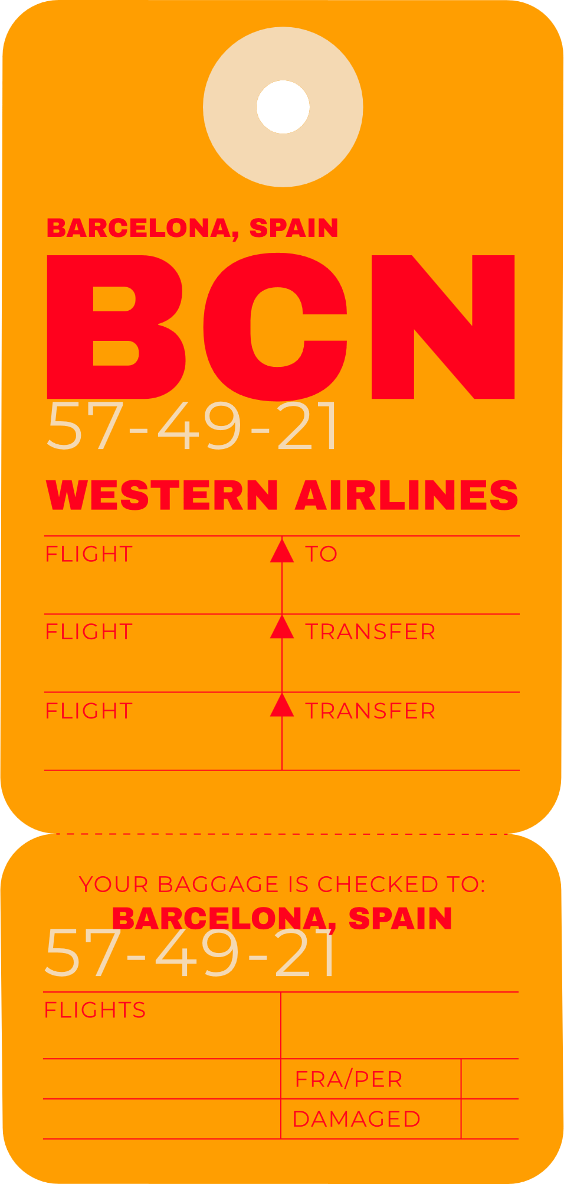

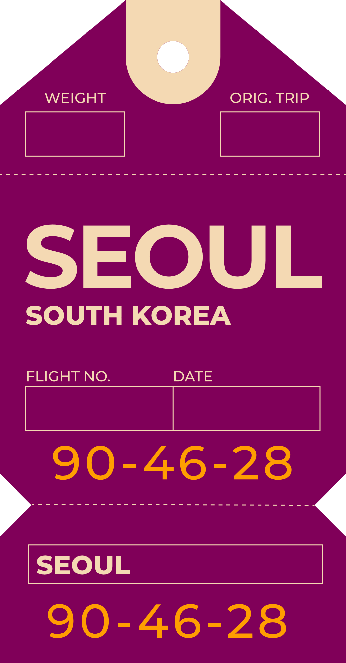

THANK YOU FOR LISTENING!
Don't hesitate to ask any questions!

